Slide 1

AstroCel S+
Post Product Launch
Sep 21

Slide 2
AstroCel I, II & III

Slide 3
AstroCel S+ HEPA filter
The Product Overview
Fiberglass media immobilized with the antimicrobial properties to combat microorganisms.
The new innovated filter media material prepared for particle aerosols (trapping) and bioaerosols (inactivate) preventing them to growth.
The antimicrobial agent is Non-dermally-irritating.
Effective over a broad PH range (2 – 11).
Harmlessness to human body and environmental friendliness
Available for AstroCel I, II & III S+ HEPA filters
The filter media performance against the Bacteria and Viruses through the laboratory testing complete with a test report (Influenza A Virus (H1N1) pandemic (Human Isolated), Human coronavirus 229E – Tested in Thailand)
Non dermally-irritating Designed to be used in situations where dry blending of ingredients is desired. Applications Adhesives, coatings, caulks, textiles. Related Applications Adhesives.

Slide 4
AstroCel S+ HEPA filter
Antimicrobial Mechanism
The key performance goal is to reduce the growth of microbial organisms in the filter components
The intent is not to make the air clean and free of viable microbes, but rather to prevent filter components from becoming the microbial reservoir.
Prevents formation of cell protein and cell walls
Disrupts Energy metabolism and development or microorganism.
Fusion with cell membrane and enters the cell through the structures of organelles, protein, nucleic acids, etc. The active ingredients destroys cell contents, enzymes, proteins, nucleic acids in order to inhibit bacteria and mold reproduction.
nucleic acid – a complex organic substance present in living cells, especially DNA, RNA whose molecules consist o many nucleotides linked in a long chain

Slide 5
AstroCel S+ HEPA filter
The Production Method
Addition of antibacterial solution during the manufacturing process of air filtration media.
Active ingredients of antibacterial solution is immobilized (acrylate adhesive bonding) on the surface of the air filtration media, providing antibacterial properties.
When microorganisms comes into contact with the air filtration media, the antibacterial solution emits the protection effect through the penetration of cell wall and the destruction of essential and important cell functions.
Microorganism are unable to function, grow and reproduce

Slide 6
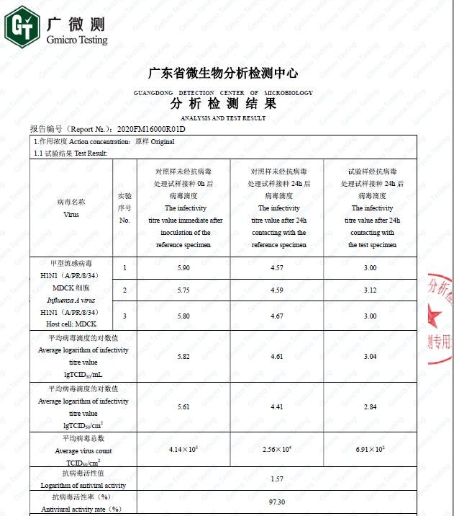
S+ Media Test Report from Supplier – H1N1

Slide 7
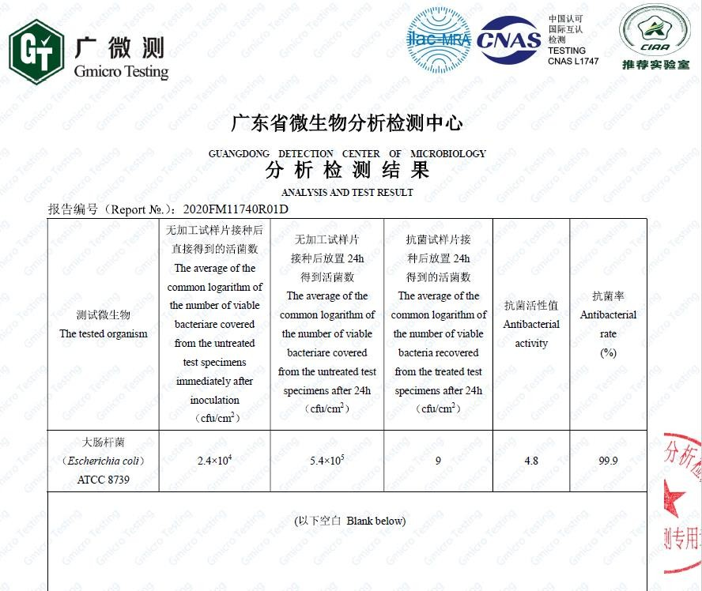
S+ Media Test Report from Supplier - Antimicrobial

Slide 8
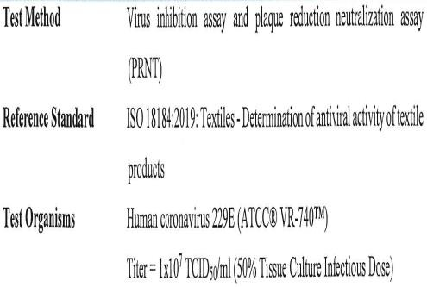
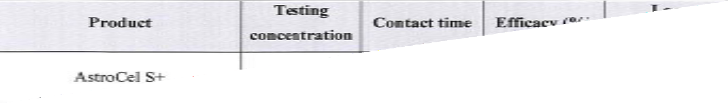
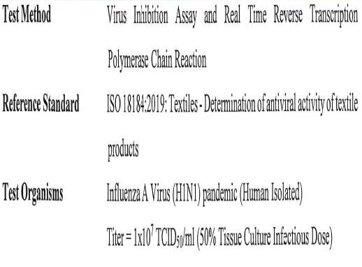
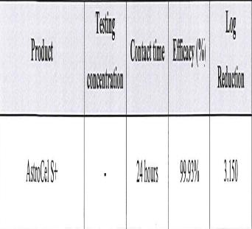
S+ Media Test Report – Thailand
(Human coronavirus 229E)
S+ Media Test Report – Thailand
(Influenza A Virus (H1N1) pandemic (Human Isolated)

Slide 9
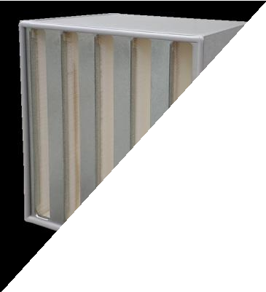
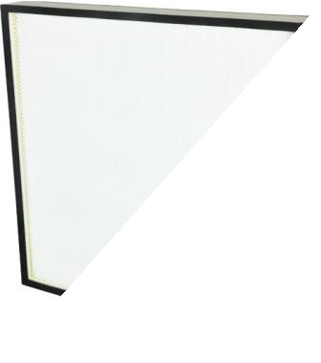
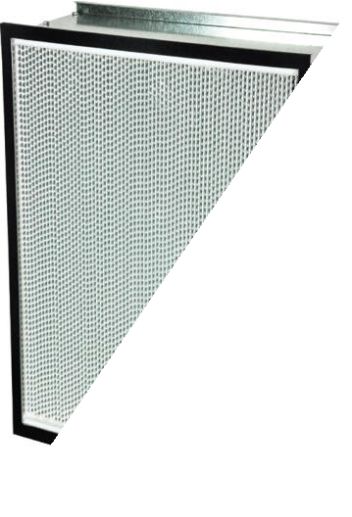
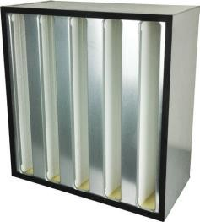
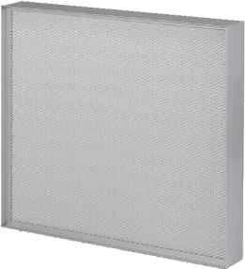
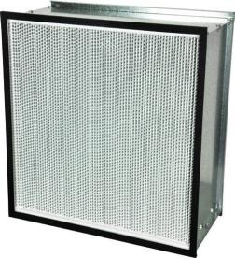
Available Product Range with S+ Media
AstroCel III S +
AstroCel II S +
AstroCel I S +
Performance
AstroCel III
AstroCel II
AstroCel I
New
Existing
Price

Slide 10
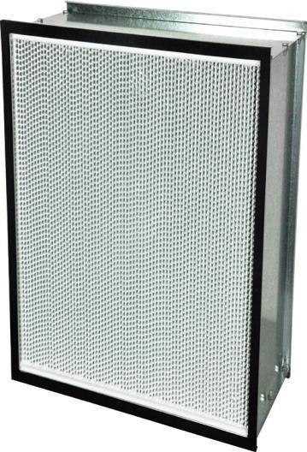
AstroCel I S+ HEPA Filter
Specification | Description
EN1822 | H13, H14
Filter Depth (mm) | 149 & 292
Media Type | Fibreglass with antimicrobial properties
Frame material (Standard) | GI
Frame material (Optional) | Aluminium, Stainless steel, Plywood, Particle board
Separator Style | Aluminium
Gasket Material (Standard) | Neoprene
Gasket Material (Optional) | PU, EPDM, PU Gel
Gasket Position (Standard) | Downstream
Gasket Position (Optional) | Upstream, Both sides
Faceguard | No
Special Size Available | Yes
Header Type | Non Header
Antimicrobial Available | Yes
Recommended Final Resistance | 750 Pa
Max Operating Temperature | 90°C
Test Report | JIS Z 2801 & ISO 18184

Slide 11
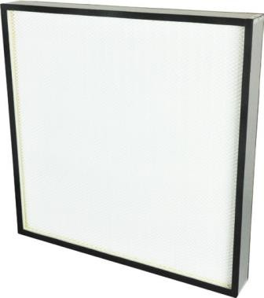
AstroCel II S+ HEPA Filter
Specification | Description
EN1822 | H13, H14
Filter Depth (mm) | 69, 93, 117
Media Type | Fibreglass
Frame material | Aluminium
Separator Style | Hot Melt
Gasket Material (Standard) | Endless PU
Gasket Material (Optional) | Neoprene, EPDM
Gasket Position (Standard) | Downstream
Gasket Position (Optional) | Upstream, Both sides
Faceguard | Both sides
Special Size Available | Yes
Antimicrobial Available | Yes
Recommended Final Resistance | 500 Pa
Max Operating Temperature | 70°C
Test Report | JIS Z 2801 & ISO 18184

Slide 12
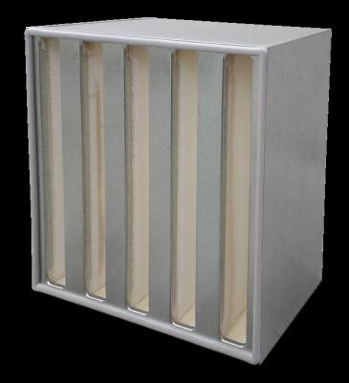
AstroCel III S+ HEPA Filter
Specification | Description
EN1822 | H13
Filter Depth (mm) | 292
Media Type | Fibreglass
Frame material (Standard) | GI
Frame material (Optional) | Stainless steel, Aluminium
Separator Style | Hot Melt
Gasket Material (Standard) | Endless PU
Gasket Material (Optional) | Neoprene, EPDM
Gasket Position (Standard) | Downstream
Gasket Position (Optional) | Upstream, Both sides
Special Size Available | No
Antimicrobial Available | Yes
Recommended Final Resistance | 500 Pa
Header Type | Non Header
Recommended Final Resistance | 750 Pa
Max Operating Temperature | 70°C
Test Report | JIS Z 2801 & ISO 18184

Slide 13
AstroCel S+ Vs Std Glassfibre
AstroCel I
 |  | AstroCel I HEPA (Standard) |  | AstroCel I S+ (Antimicrobial HEPA)
EN1822 | Size (mm) | Rated Airflow (CMH) | Rated Initial Resistance (Pa) | Rated Airflow (CMH) | Rated Initial Resistance (Pa)
H13 | 610 x 305 x 149 | 375 | 250 | 425 | 250
 | 610 x 610 x 149 | 850 |  | 850
 | 610 x 305 x 292 | 750 |  | 850
 | 610 x 610 x 292 | 1700 |  | 1700
H14 | 610 x 305 x 149 | 375 | 250 | 425 | 260
 | 610 x 610 x 149 | 850 |  | 850
 | 610 x 305 x 292 | 750 |  | 850
 | 610 x 610 x 292 | 1700 |  | 1700
H13 (HC) | 610 x 305 x 149 | 750 | 350
 | 610 x 610 x 149 | 1700
 | 610 x 305 x 292 | 1500
 | 610 x 610 x 292 | 3400
H14 (HC) | 610 x 305 x 149 | 750 | 350
 | 610 x 610 x 149 | 1700
 | 610 x 305 x 292 | 1500
 | 610 x 610 x 292 | 3400
AstroCel II
 |  | AstroCel II HEPA (Standard) |  | AstroCel II S+ (Antimicrobial HEPA)
EN1822 | Size (mm) | Rated Airflow (CMH) | Rated Initial Resistance (Pa) | Rated Airflow (CMH) | Rated Initial Resistance (Pa)
H13 | 610x610x69 | 600 | 105 | 600 | 115
 | 610x1220x69 | 1205 |  | 1205
 | 610x610x93 | 600 | 75 | 600 | 85
 | 610x1220x93 | 1205 |  | 1205
 | 610x610x117 | 600 | 65 | 600 | 75
 | 610x1220x117 | 1205 |  | 1205
H14 | 610x610x69 | 600 | 135 | 600 | 135
 | 610x1220x69 | 1205 |  | 1205
 | 610x610x93 | 600 | 95 | 600 | 95
 | 610x1220x93 | 1205 |  | 1205
 | 610x610x117 | 600 | 80 | 600 | 80
 | 610x1220x117 | 1205 |  | 1205
AstroCel III
 |  | AstroCel III HEPA (Standard) |  | AstroCel III S+ (Antimicrobial HEPA)
EN1822 | Size (mm) | Rated Airflow (CMH) | Rated Initial Resistance (Pa) | Rated Airflow (CMH) | Rated Initial Resistance (Pa)
H13 | 610 x 305 x 292 | 1500 | 250 | 1750 | 250
 | 610 x 610 x 292 | 4000 |  | 3500 | 250
H14 | 610 x 305 x 292 | 1400
 | 610 x 610 x 292 | 3500

Slide 14
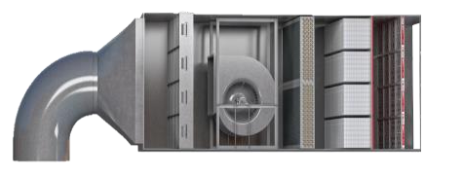

AstroCel S+
Bringing clean air to life
Product Value
The additional antibacterial mechanism being added
2 in 1 solution - inactivating bacterial or viruses and trapping particles at the same time.
The active ingredients destroys cell contents, enzymes, proteins, nucleic acids in order to inhibit bacteria and mold reproduction.
S+ is able to inactivate bacteria or virus comparing to standard glassfibre.
The processability and functionality is the same as the standard glassfibre including filter classification.
Available filter efficiency as H13 & H14
Available AstroCel product range from I, II & III.
Not commonly available in the current market
Test reports available from media supplier and isolated test done in Thailand – The result achieved is very promising.
The storage condition same as the standard glassfibre.

Slide 15
AstroCel S+
Bringing clean air to life
Product Positioning
Suitable for indoor application
Suitable to be installed in any new or existing equipment with the right design.
Avoid high RH (take reference from glassfibre), direct rainwater contact, and high concentration of chemical present.
The processability and functionality, installation, storage condition of the S+ media are the same as standard glassfibre.
Take necessary precautions if the installation is done incorporating with the UVC under one housing.
Follow the recommended operational temperature as the standard glassfibre.
Required good filtration at the upstream of the S+ media to prolong its service life – dust clogging will reduce not only the filter efficiency but the effectiveness of the antimicrobial too.
Recommended for Healthcare and Pharmaceutical segment at the
current moment

Slide 16

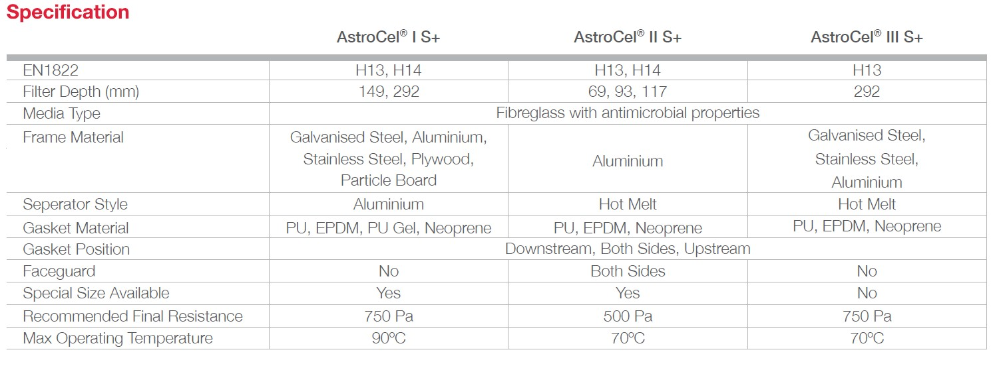
Quick Summary on the AstroCel S+

Slide 17
Frequently ask questions to share?
Provide the comparison table between standard HEPA and Antivirus HEPA in terms of TP,
pressure drop Vs airflow Vs size, and the delivery lead time?
From the comparison table from above(full product launch slides), there is a 10 Pa increase between standard and antimicrobial HEPA for H13 while for H14, the pressure drop/initial resistance remains the same. The delivery time is expected to be the same as the standard HEPA filter.
Any special terms and conditions (Air temp, RH, etc) to take note of the Antivirus HEPA filter during installation?
Although the antibacterial component is added into the HEPA-grade air filtration media, it does not affect the physical nature of the media. Hence, all the processability and functionality of the media are the same as the standard glass fibre media, the installation conditions should remain the same as the standard installation for HEPA filters.

Slide 18
The Product Launch Announcement
We are pleased to announce to you that the AstroCel I, II & III S + media has been officially launched on Sep 2021 to all our sales teams, distributors and business partners.

Slide 19
We can provide a better service to you if you can provide us your sales forecast on the mentioned products promptly to mitigate the long delivery lead time
Kindly contact our customer service in Malaysia plant for the TP and detail.
Thank You

